Slide 1


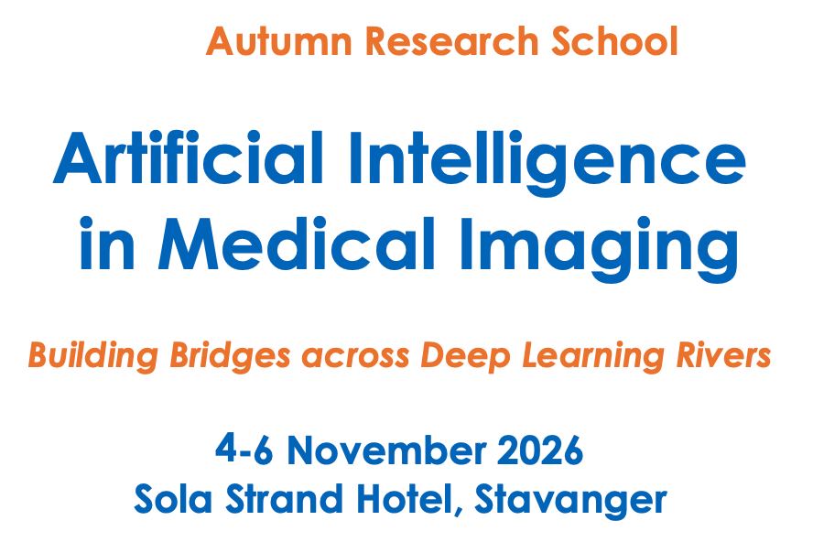


From Brains to Models: What AI Reveals About Being Human
Arvid Lundervold BSc, MD, PhD
Professor em. medical information technology and physiology
Department of Biomedicine, University of Bergen, Norway

Slide 2
From Brains to Models: What AI Reveals About Being Human
Motivation and Inspiration

Slide 3
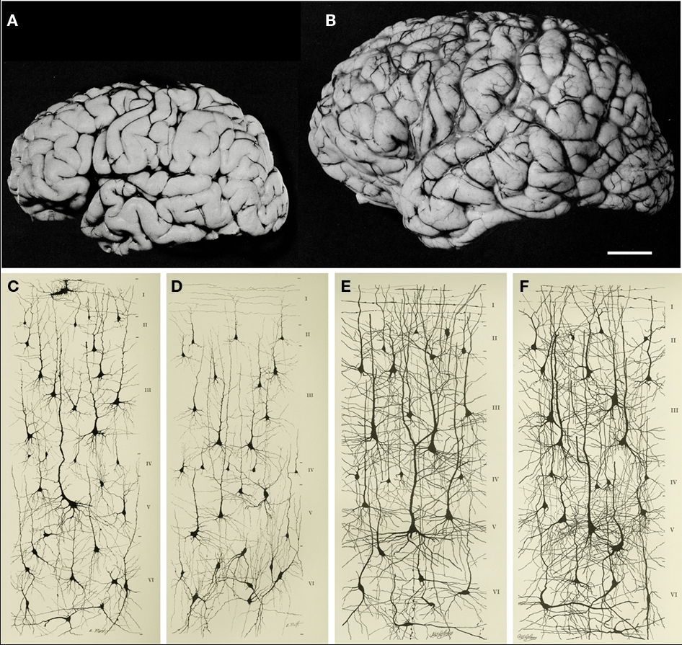
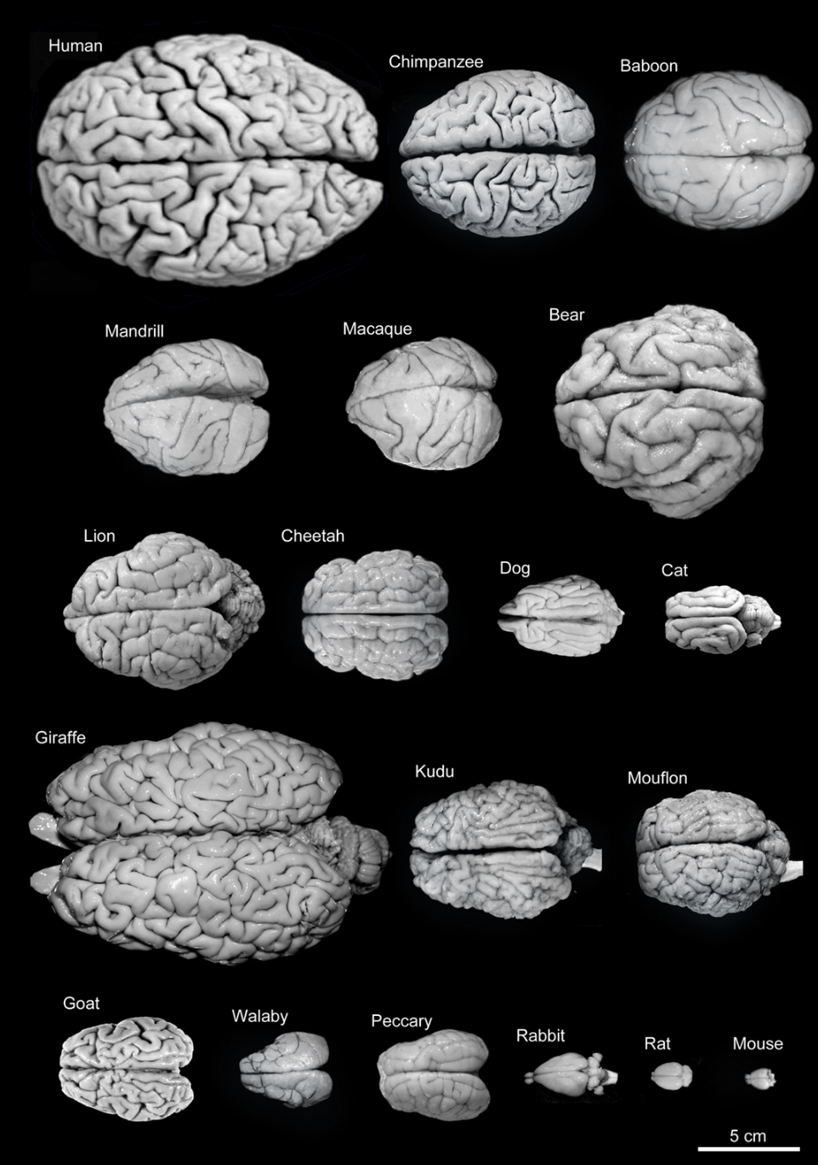
From BRAINS ….
1 month
6 yrs
2 cm
Orbital gyrus (1 month)
Orbital gyrus (6 yrs)
Pars triangularis of gyrus frontalis inferior (1 month)
Pars triangularis of gyrus frontalis inferior (6 yrs)
Frontiers in Neuroanatomy 16 May 2011 https://doi.org/10.3389/fnana.2011.00029
J. DeFelipe. The evolution of the brain, the human nature of cortical circuits, and intellectual creativity https://pubmed.ncbi.nlm.nih.gov/21647212

Slide 4
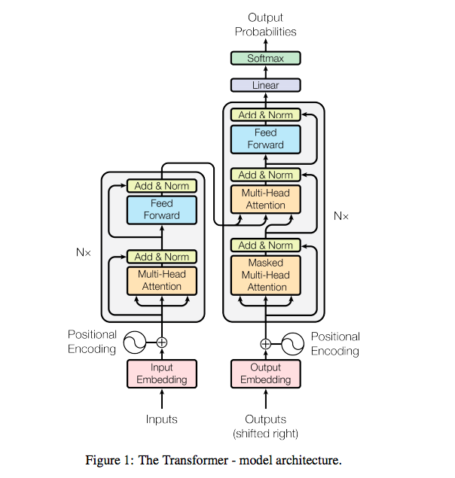
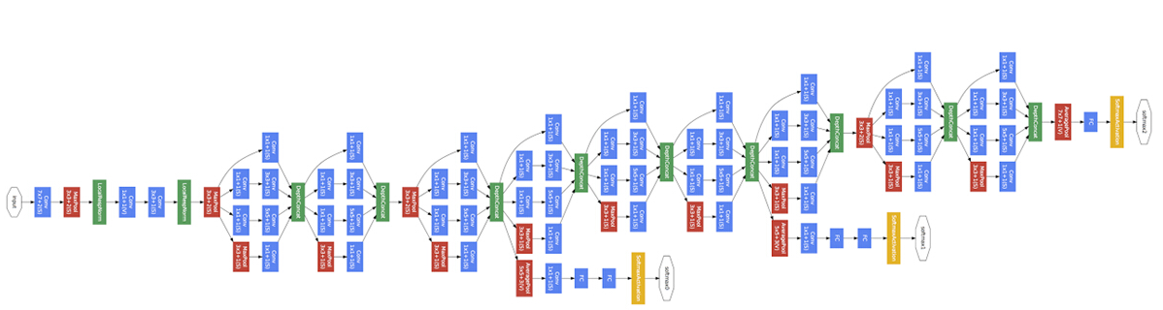
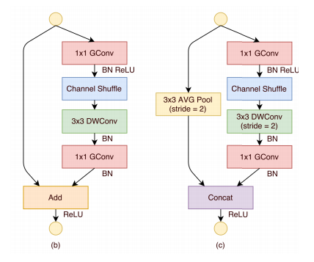
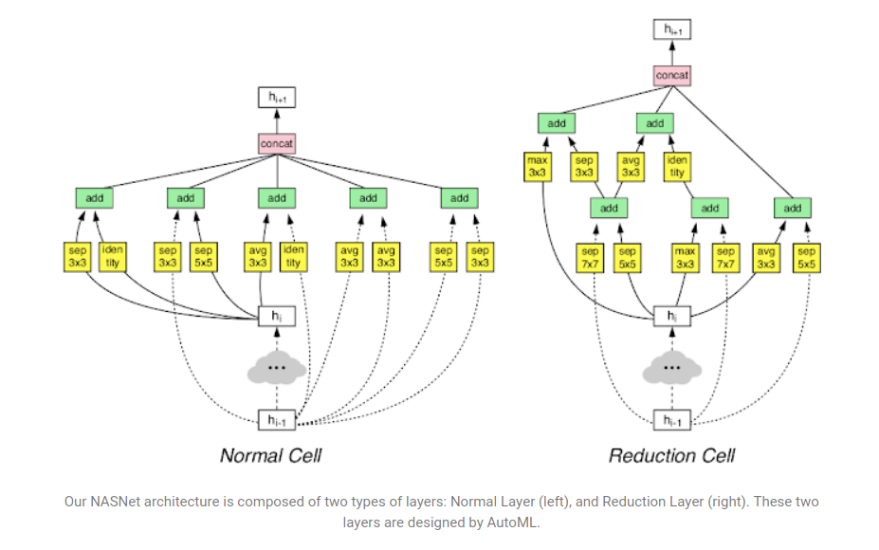
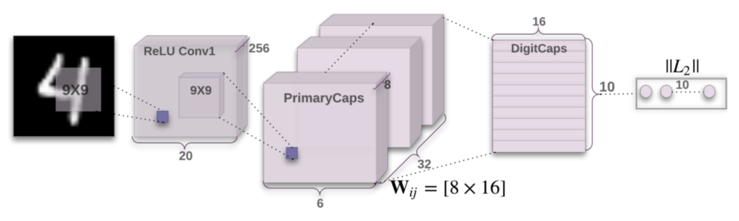
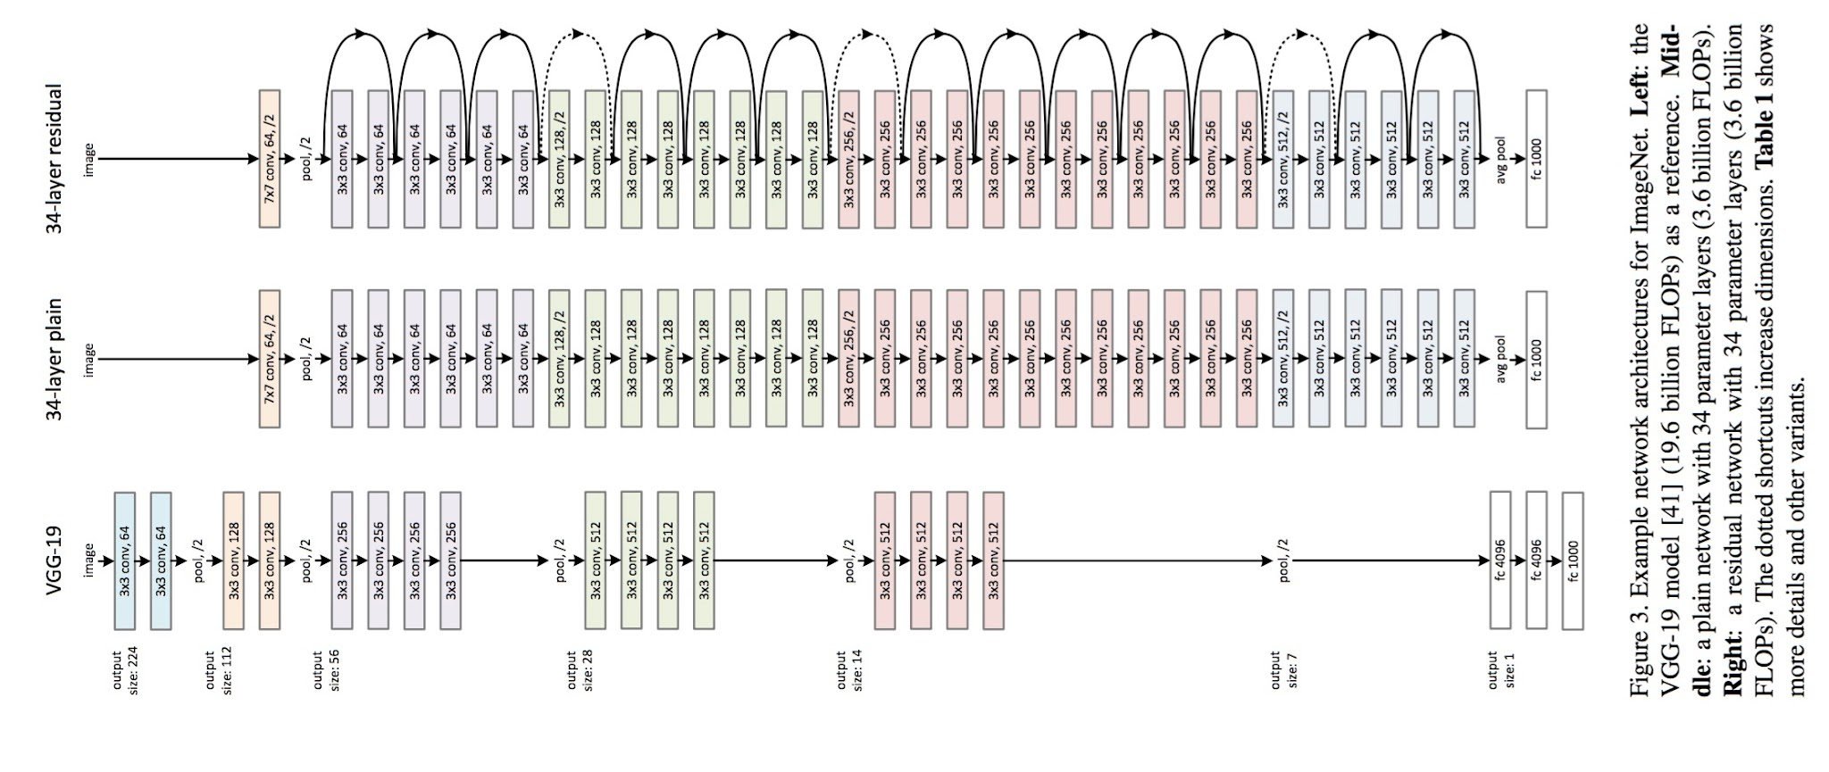
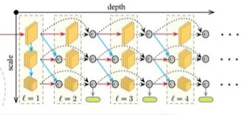
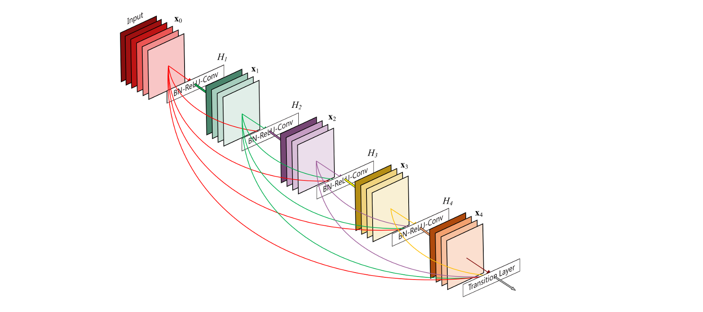
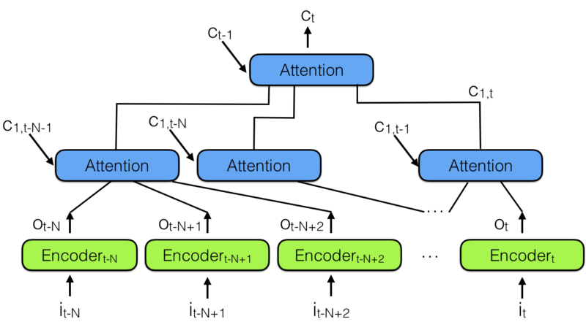
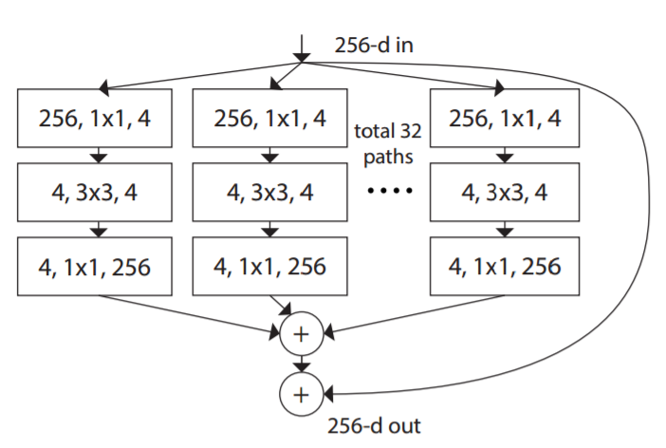
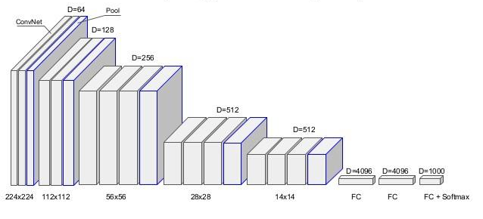
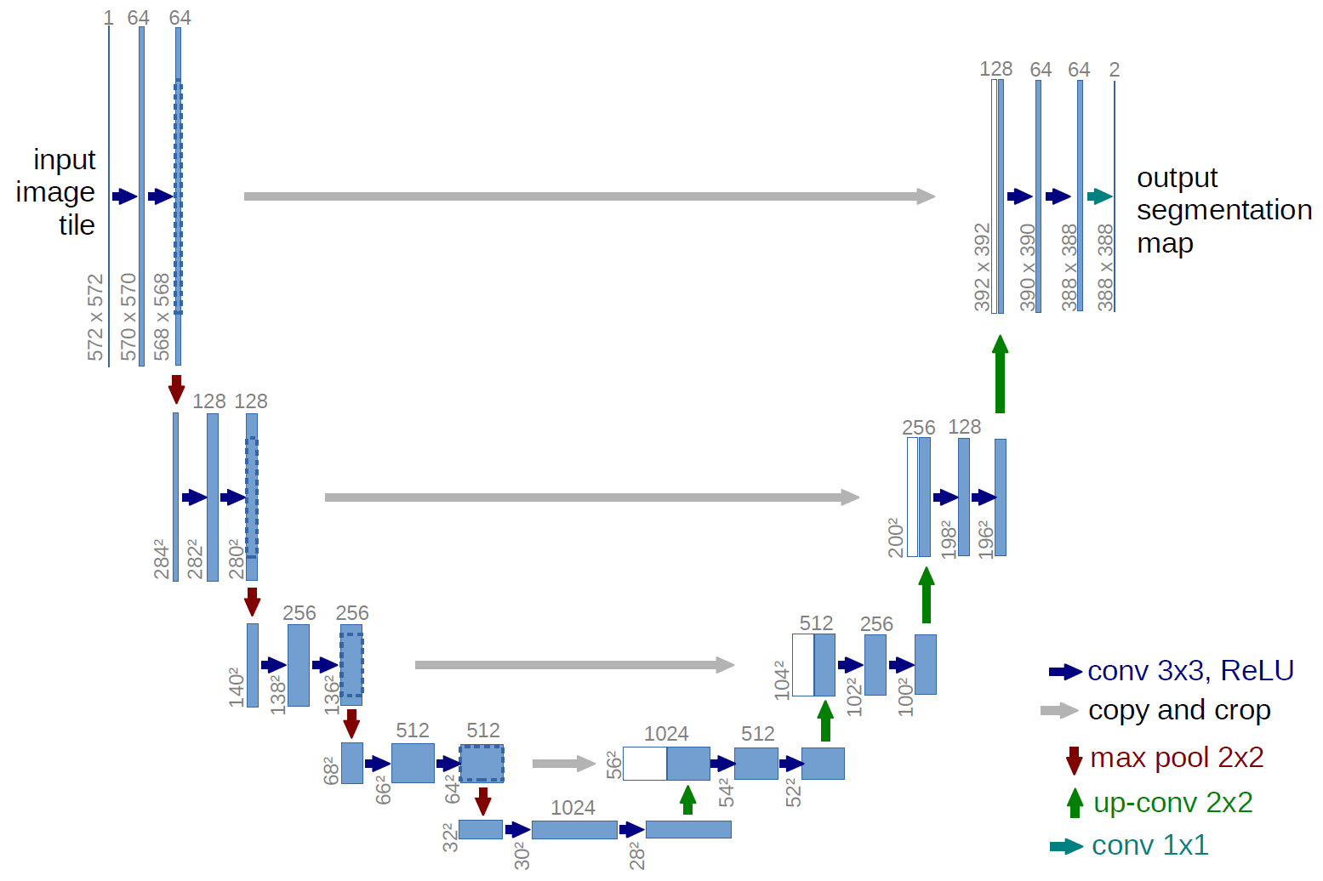
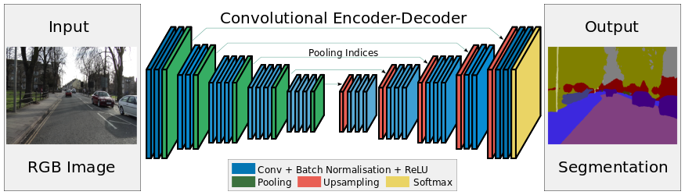
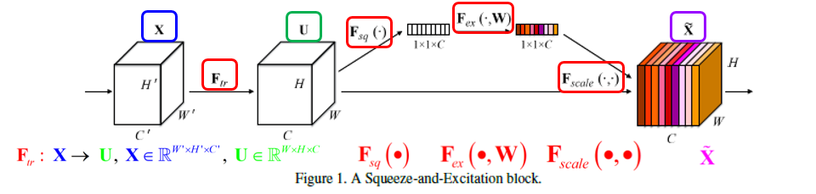
to MODELS ….
NASNet/
AmoebaNet
Transformer
Inception / GoogLeNet
ShuffleNet
CapsNets
ResNet
Hierarchical neural attention encoder
Multiscale DenseNet
DenseNet
ResNext
VGG
U-Net
SegNet
Squeeze and excitation

Slide 5
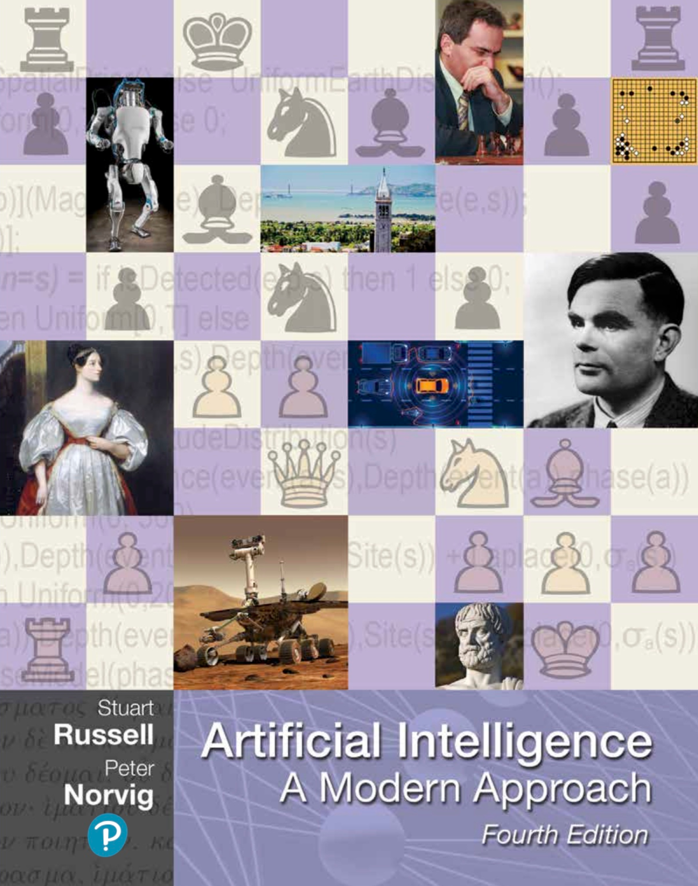
Artificial intelligence (AI)
Machines that can sense, reason, act, and adapt
Agents that receive input from their environments and perform actions
Understand intelligence
&
Build intelligent systems
Human performance Rationality
Thought processes Thinking humanly Thinking rationally
and reasoning
(Cognitive science) (Laws of thought)
Behavior Acting humanly Acting rationally
(Turing test) (Rational agent)
Adapted from Russell & Norvig, 2009
https://aima.cs.berkeley.edu

Slide 6



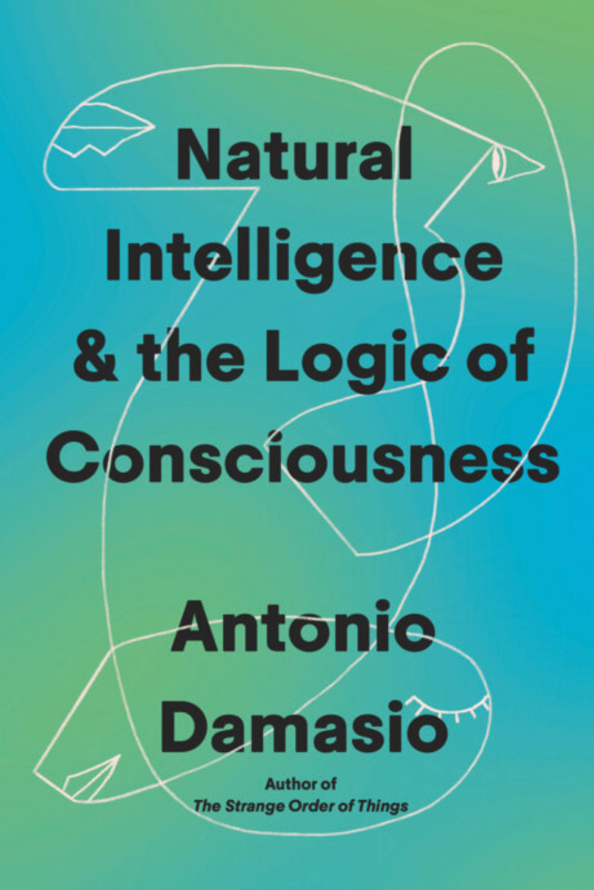

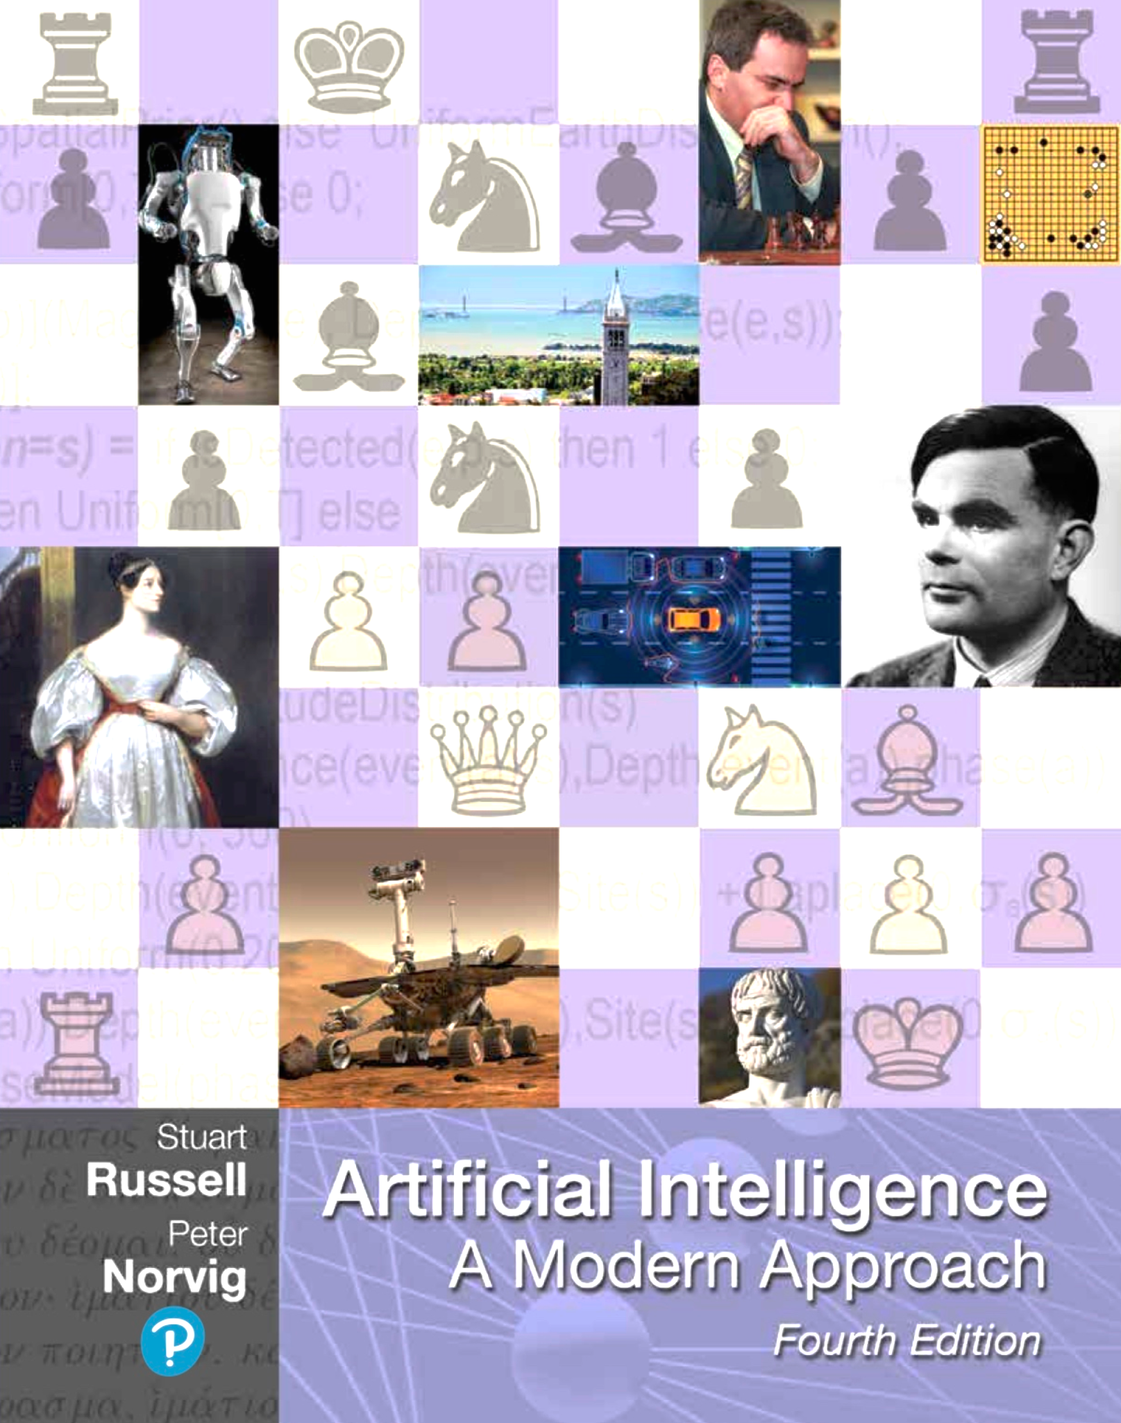
Artificial intelligence (AI)
Machines that can sense, reason, act, and adapt
Agents that receive input from their environments and perform actions
Understand intelligence
&
Build intelligent systems
Super intelligence
https://x.ai
Human performance Rationality
Thought processes Thinking humanly Thinking rationally
and reasoning
(Cognitive science) (Laws of thought)
Behavior Acting humanly Acting rationally
(Turing test) (Rational agent)
Cognitive neuroscience
AI-reasoning
Human judgement
https://youtu.be/3IPQ-qfDg_I
Interoception
Feelings
Consciousness
Homeostasis
https://co-existence.ai
Human-AI
collaboration
based on Russell & Norvig, 2009
https://aima.cs.berkeley.edu

Slide 7
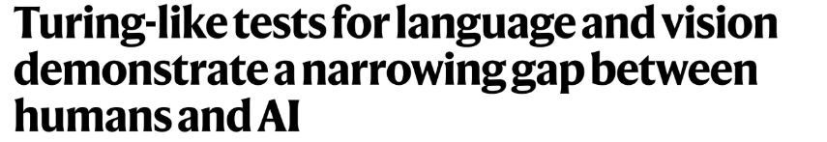
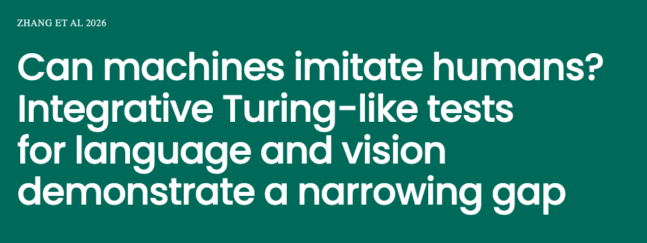

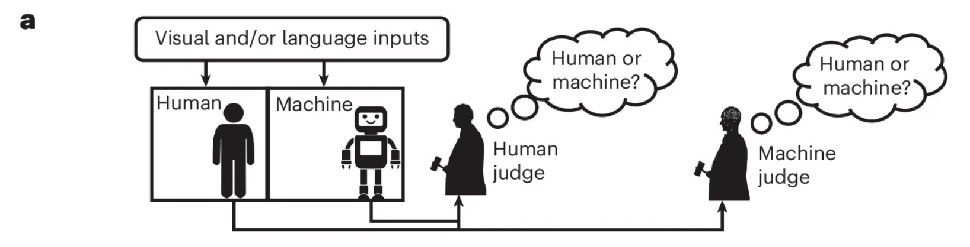
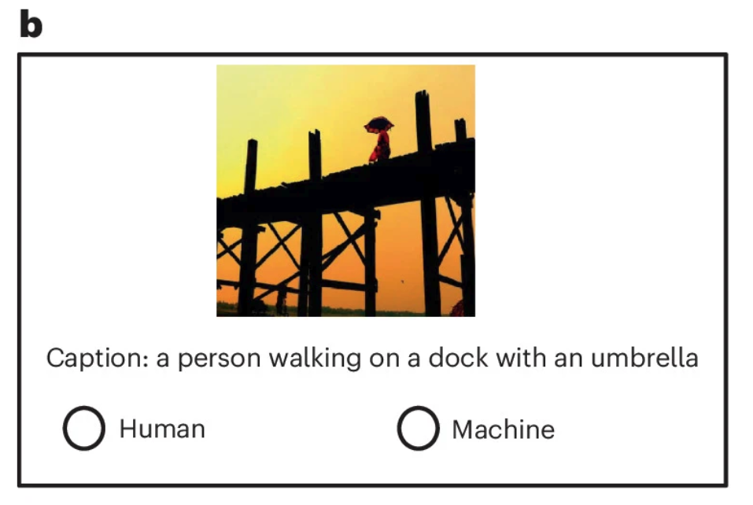
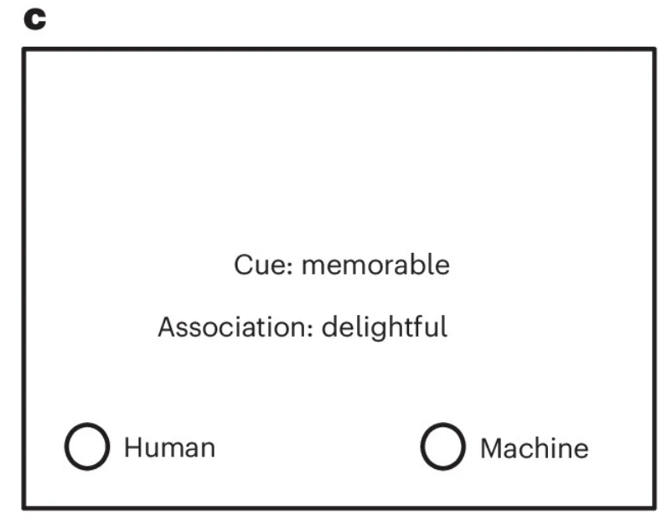
Paper & Code:
https://kreimanlab.com/code/testing-turing-tests
https://github.com/kreimanlab/TuringTest
26 October 2026
Design: 636 humans and 37 AI models answered six language and vision tasks, and over 72,000 Turing-like tests checked whether judges could tell them apart
Human judges: they performed near chance, so AI responses were largely indistinguishable from human ones
One model for everything: GPT-4o matched human-likeness on all six tasks without any task-specific training
AI judges: simple classifiers detected machine responses far better than people did
Benchmarks: human-likeness was unrelated to standard accuracy metrics
Caveat: most tests were passive ratings of pre-collected responses. In live conversations where judges could question the agents, the AI was much easier to spot

Slide 8
The problem of our time is not merely information overload.
It is that the time required to construct a coherent understanding of reality is becoming longer than the time during which that understanding remains valid.
— Izabella Kaminska (@izakaminska) on X
Zhang et al. Turing-like tests for language and vision demonstrate a narrowing gap between humans and AI
Nature Human Behaviour (Published: 26 October 2026)
Here we systematically benchmark AI’s ability to imitate humans in three language tasks (image captioning, word association and conversation) and three vision tasks (colour estimation, object detection and attention prediction), collecting data from n = 636 humans and 37 AI agents (37 AI models). We also conducted 72,191 Turing-like tests with 1,916 human judges and 10 AI judges.
Most of the core models date from 2017–2022, which matches the first preprint in November 2022. The more modern models (LLaVA-1.6, Llama 3, GPT-4o) were added in later revisions.
That supports the earlier caveat: apart from the GPT-4o experiment, the “narrowing gap” is measured mostly on models that are now several generations old.

Slide 9
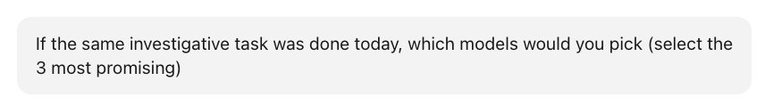
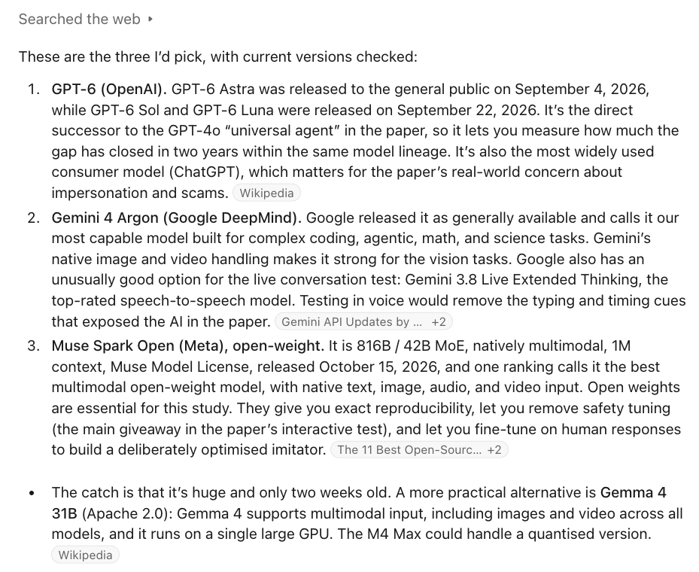
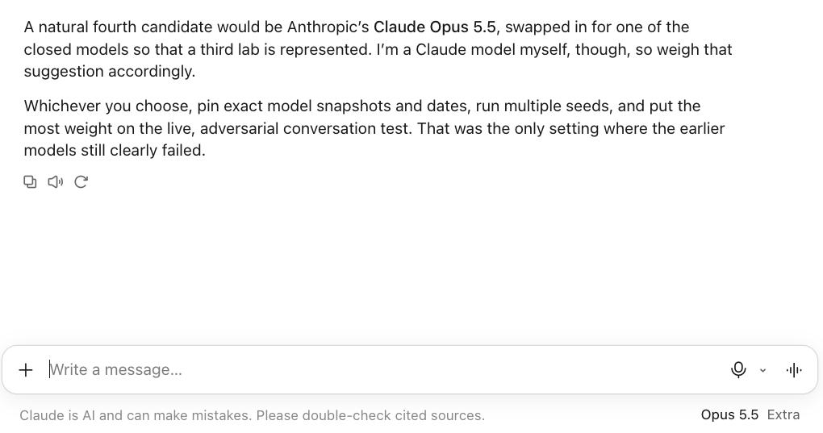
Zhang et al. Turing-like tests for language and vision demonstrate a narrowing gap between humans and AI Nature Human Behaviour (Published: 26 October 2026)
28 October 2026

Slide 10
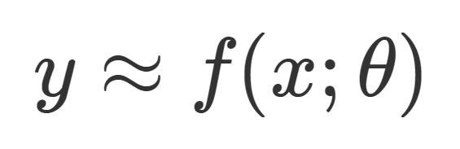
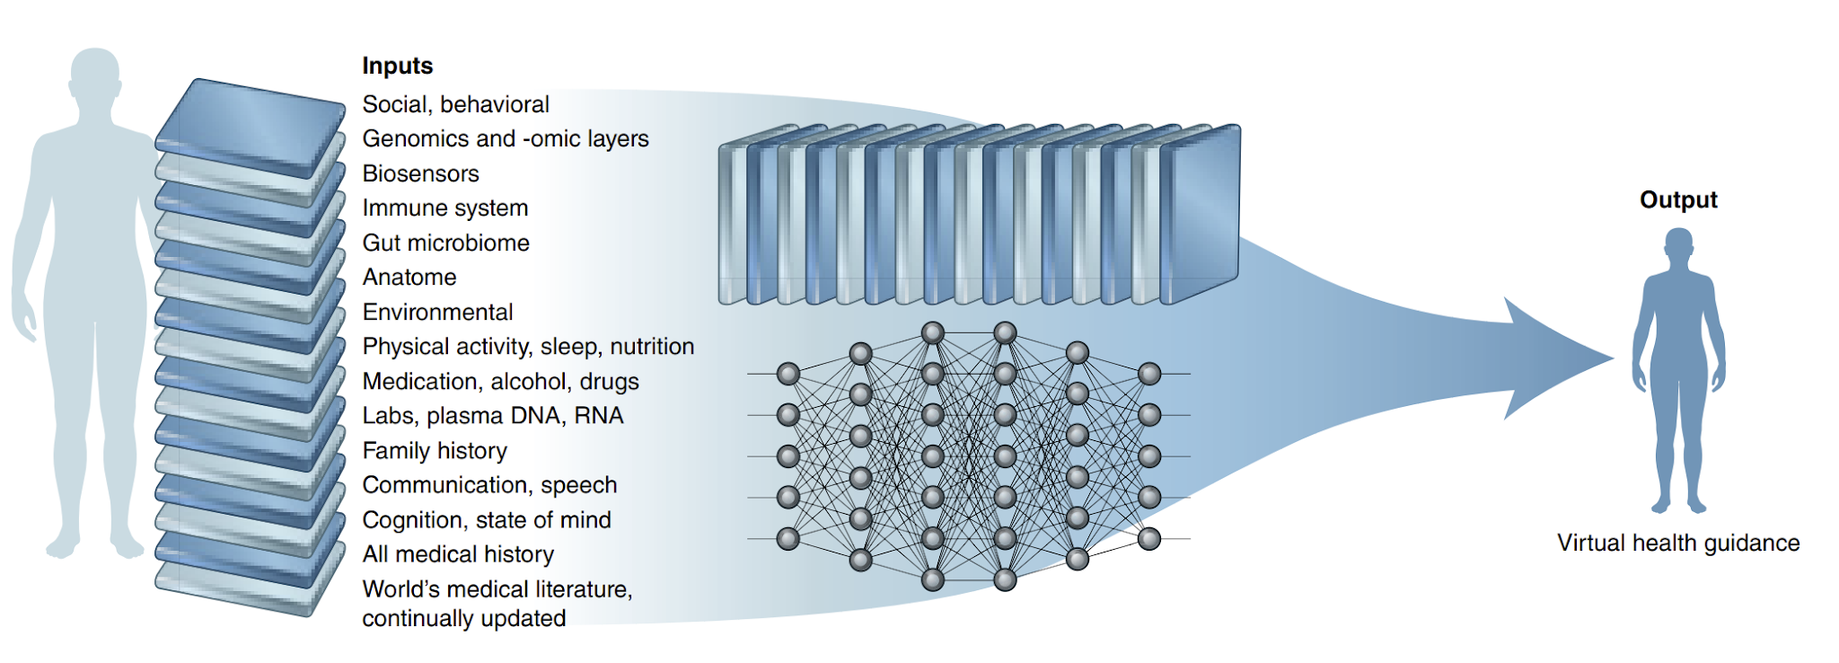


From multimodal patient data to personalised health predictions and guidance
- model architecture
Health guidance
Diagnosis
Phenotype
Overall survival
...
model parameters
Modified from: E. J. Topol, ‘High-performance medicine: the convergence of human and artificial intelligence’, Nature Medicine 2019;25:44–56. https://www.nature.com/articles/s41591-018-0300-7

Slide 11

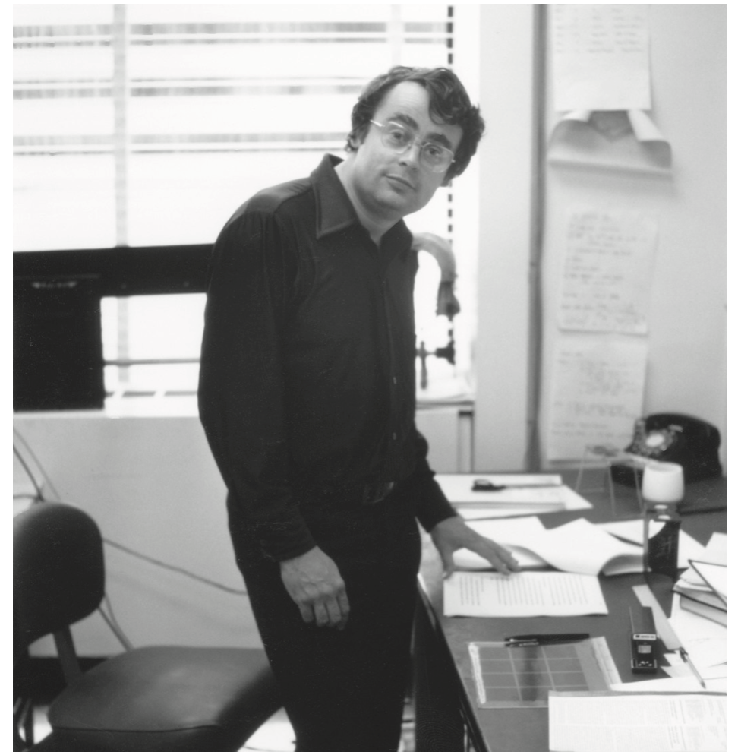
David Marr (1945-1980)
at MIT
David Marr (1982) • Vision & Imaging Framework
Three Levels of Abstraction in Information-Processing Systems
01
Computational Level
(What and Why)
Definition
The most abstract level. Defines system goal and purpose.
Key Questions
What is the goal? What is the input-output mapping?
Example (Medical Imaging)
Reconstructing a 3D anatomical volume from 2D MRI/CT slices to quantify tumor size.
02
Algorithmic Level
(How / Representational)
Definition
Specifies input/output representations and algorithmic steps.
Key Questions
How is image data represented and processed iteratively?
Example (Medical Imaging)
Edge detection filters, deep CNN feature maps, and deformable mesh segmentation algorithms.
03
Implementational Level
(Physical Realization)
Definition
Physical substrate where algorithms and representations exist.
Key Questions
What physical hardware or biological structures execute it?
Example (Medical Imaging)
RF coil arrays and analog-to-digital converters capturing k-space signals, then GPU clusters executing reconstruction and deep-learning segmentation.
Example (Vision)
Deciding that the visual system must take a 2D retinal image and build a 3D representation of objects in the world.
Example (Vision)
Using edge detection, primal sketches, and hierarchical layers of representations to process visual features.
Example (Vision)
Firing rates of retinal ganglion cells, photoreceptors (rods and cones), and visual cortex pathways.
David Marr: Vision - A Computational Investigation into the Human Representation and Processing of Visual Information. San Francisco: W. H. Freeman and Company, 1982

Slide 12

0. Introduction
1. Co-Existence
2. Scale
3. How to Think Like an AI
4. How to Work with AI
5. How to Think Like a Human
6. When to Use AI
7. AI and Work
8. Education
9. Society
10. Who Is on the Other End of the Line?
11. The Elevator and the Eschaton
Highly recommended
20 October 2026
https://co-existence.ai

Slide 13
MAINTAINING YOUR HUMAN EDGE
When to step back from AI, and how to level up (Ethan Mollick, Co-Existence)
WHEN TO STEP BACK
FOUR HUMAN ADVANTAGES
Learning: Struggle builds memory. Students who leaned on AI for homework scored up to 17% lower on exams
Building expertise: Skill in writing, science, and business comes from trying, failing, and revising
Effort that carries meaning: A handwritten note matters because someone took the time
When accuracy is critical: AI can be confidently wrong, and one error can be costly (“hallucinations”)
Unpredictable failures: AI may agree with you too readily, or build one mistake on another (“sycophancy”)
Deep knowledge
Expertise lets you catch plausible-sounding AI errors and handle cases AI has never seen
1
Wide knowledge
Ideas from other fields (e.g., wabi-sabi in design) help you get more out of AI
2
Taste
As AI floods us with mediocre content (slop), recognizing what is good becomes rare and valuable
3
AI in competitive games
Go (after AlphaGo): Players became more creative and reached record performance
Chess (after early engines): Players got stronger but lost skill at reading opponents
Agency
The drive to push, experiment, and act without being told. AI does not have this
4

Slide 14
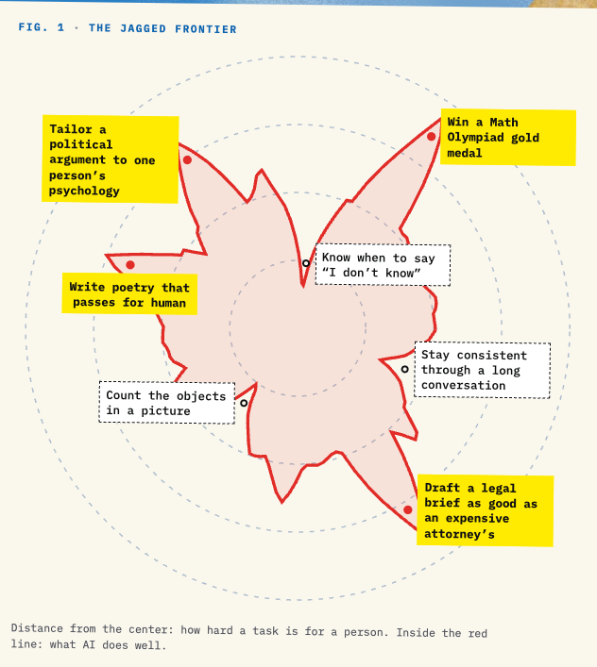
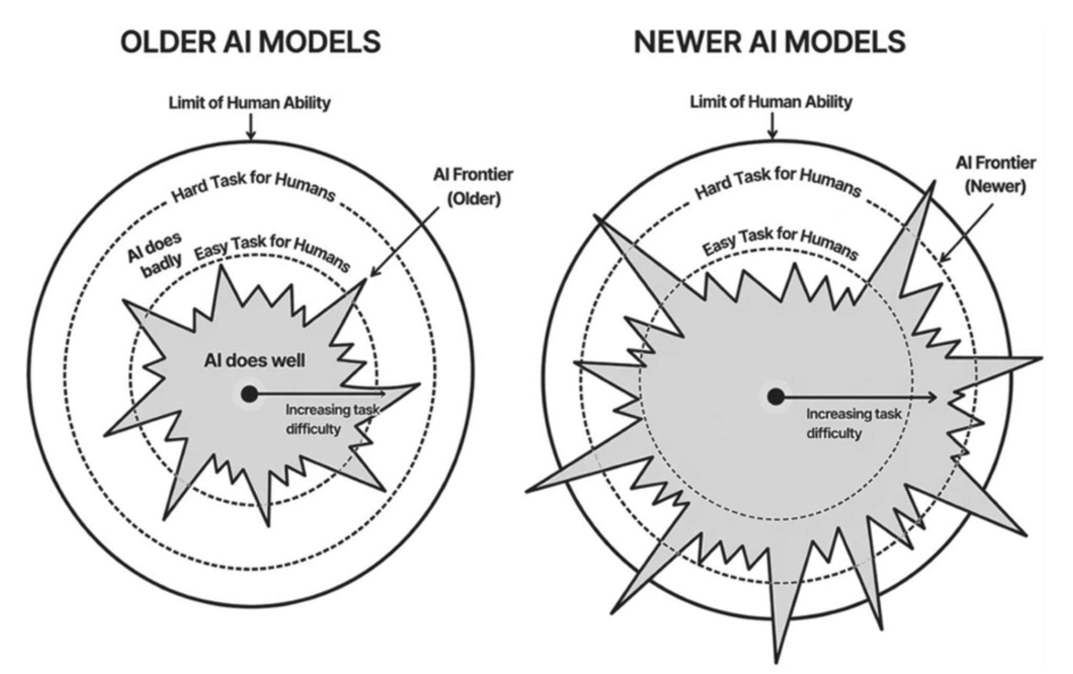
What AI Reveals About Being Human
The jagged frontier
Modified from Ethan Mollick: Co-Existence: The Next Phase of AI, Penguin, 20 Oct 2026

Slide 15
Some good advice modified from Ethan Mollick: Co-Existence: The Next Phase of AI, Penguin, 20 Oct 2026
1. Delegate first, with structure. Hand the AI a clearly scoped task with explicit deliverables and constraints.
Defining "done" precisely makes checking the result easier; vague in → vague out
Your domain expertise is what lets you specify the task well.
2. Actually evaluate the AI's output. Read everything it produces, even when tedious.
Since you aren't supervising during execution, careful review is where your expertise counts most.
3. Iterate deliberately. Don't just ask for a retry; diagnose the failure (unclear task, missing context,
misread constraints) and improve the instructions.
A few targeted rounds usually show whether the task is achievable or beyond the AI's current abilities.
4. Know when to walk away and when to persist.
After repeated failures, do the task yourself and note what went wrong.
This becomes a benchmark for testing newer models.
When you do get the AI to succeed, have it document its working method in a text file for future reuse;
Collections of such files ("skills") help AI handle tasks it would otherwise fail at.

Slide 16

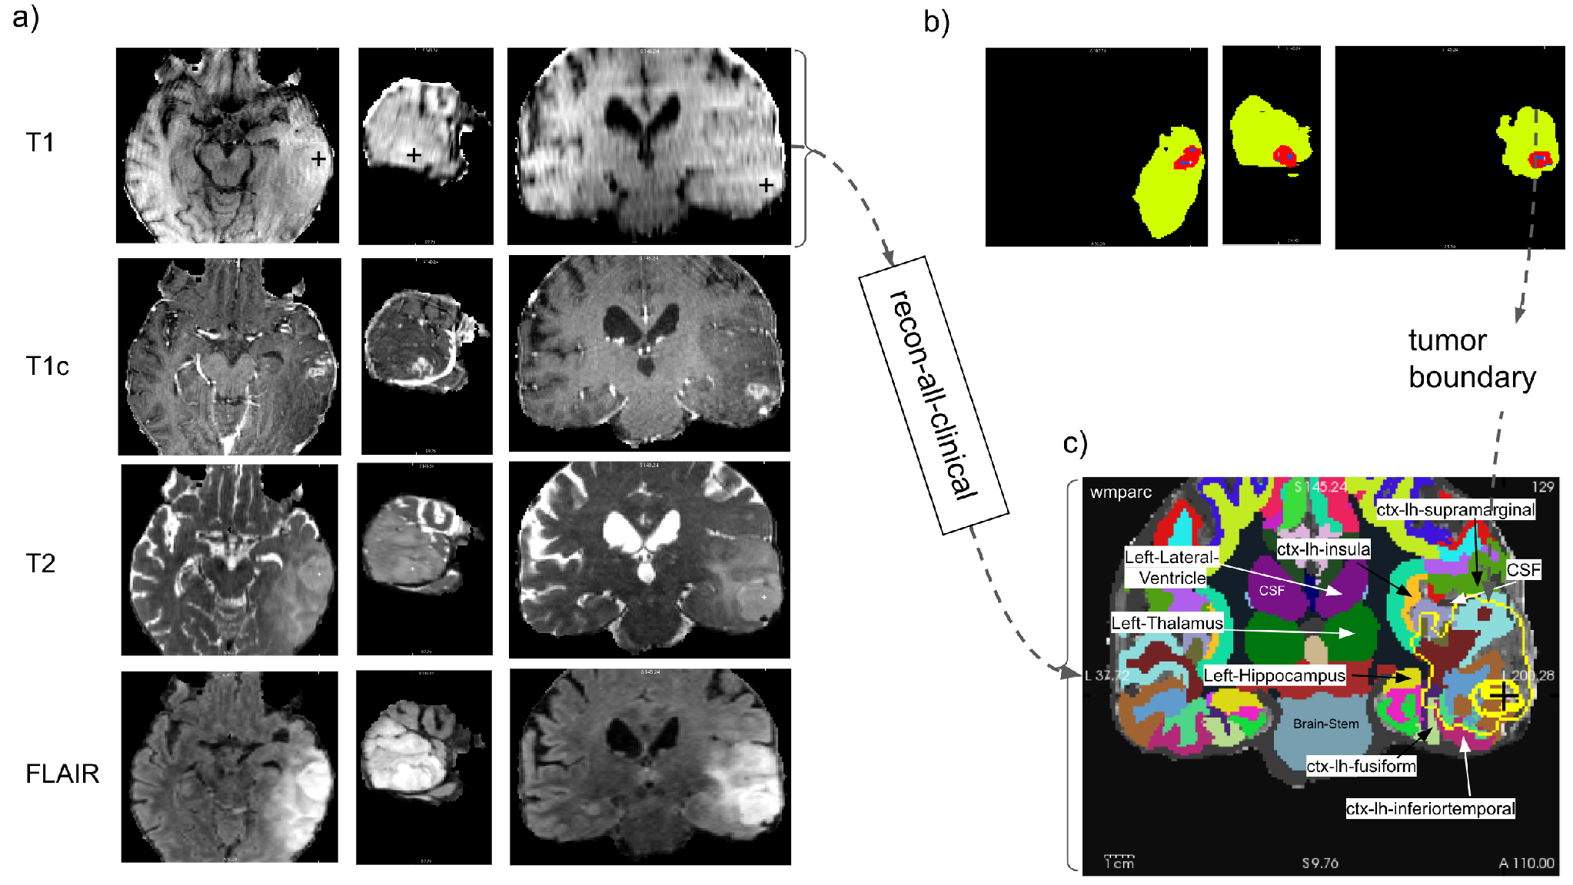
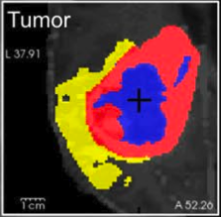
Our imaging foundation: compartments and anatomy
T1, T1c, T2, FLAIR
Trained imaging AI
MONAI SegResNet
NCR
ED
ET
FreeSurfer anatomy
Lundervold et al. 2026, Fig. 1, CC BY 4.0. UCSF-PDGM-0085; reference-mask illustration
Regional overlap volumes
Paper: Published feasibility study & Code: https://github.com/arvidl/high-precision-glioma-segmentation
AI-assisted Glioma Research
Notes:
Published imaging AI methods · 1:12 · cumulative 2:36
Our recent feasibility paper provides the imaging foundation. We combine
multiparametric MRI with three-compartment tumor segmentation and
subject-specific anatomical parcellation. The trained deep-learning imaging model, the unified MONAI BraTS SegResNet
pipeline uses T1, contrast-enhanced T1, T2 and FLAIR. The compartments are
non-enhancing or necrotic core, edema and enhancing tumor. FreeSurfer supplies
anatomical labels, and intersections produce overlap volumes and regional
profiles. In this published illustration, the compartment panel uses the
dataset's reference masks. It shows the anatomical workflow, rather than a new
prediction generated today. The public code accompanies the study. Our teaching
repository quotes its results and reuses attributed figures; it does not rerun
the trained model. [Point from MRI sequences to compartments and anatomy.]
Sources
https://doi.org/10.1080/03091902.2026.2713703
https://github.com/arvidl/high-precision-glioma-segmentation

Slide 17
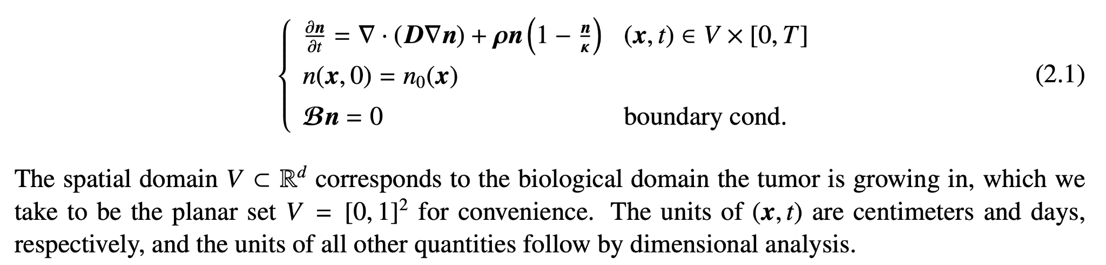
Biophysics modeling of tumor growth
The go-or-grow hypothesis*
Tumor progression as a cycle of two phases:
An initially exclusively proliferative phase followed by an invasion of tumor cells into surrounding tissues
This second phase can then possibly transition back to a proliferating phenotype, which encourages recurrence
and growth of metastatic tumors
Kolmogorov, Petrovsky, Piskunov (1937)
The Fisher-KPP model for tumor growth in the absence of treatment takes the form of a nonlinear reaction-diffusion type Partial Differential Equation (PDE) for a density of tumor cells n = n(x,t) (units number per unit volume):
diffusion
logistic growth
The first term with D is a diffusion operator that models the migration of cancerous cells into surrounding healthy tissue.
The second term with ρ models the proliferation of tumor cells that can be a logistic growth function
initial condition at time t=0
zero flux boundary condition
*H. Hatzikirou et al. 'Go or grow': the key to the emergence of invasion in tumour progression? Mathematical Medicine and Biology 2012;29(1):49-65.
**R. Everett et al. A tutorial review of mathematical techniques for quantifying tumor heterogeneity. Mathematical Biosciences and Engineering 2020;17(4):3660-3709
https://www.aimspress.com/article/10.3934/mbe.2020207

Slide 18
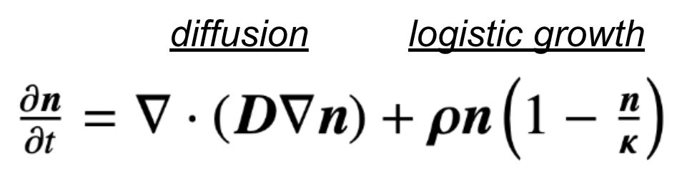

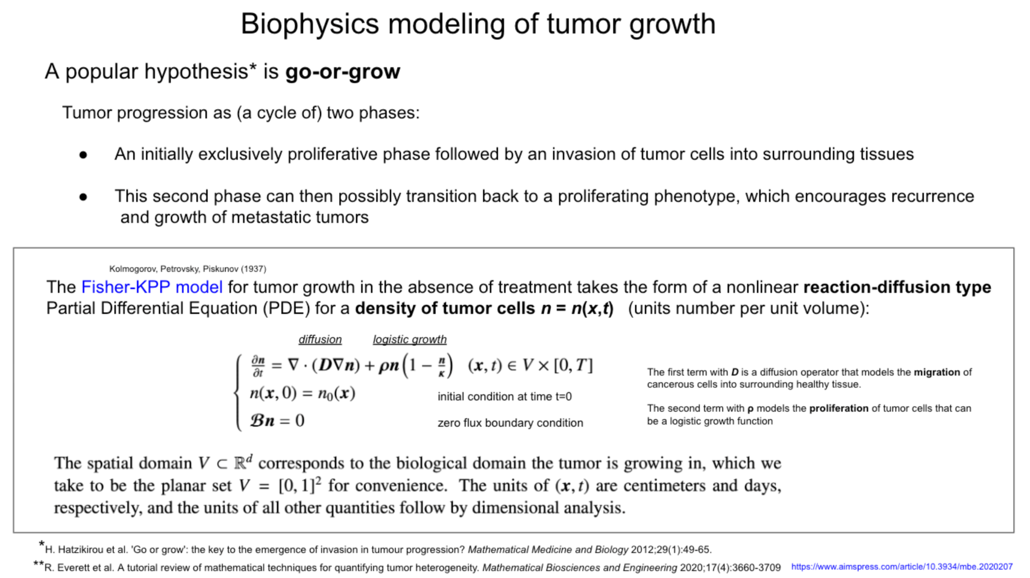
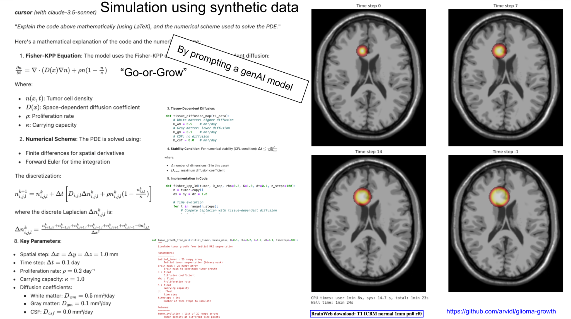
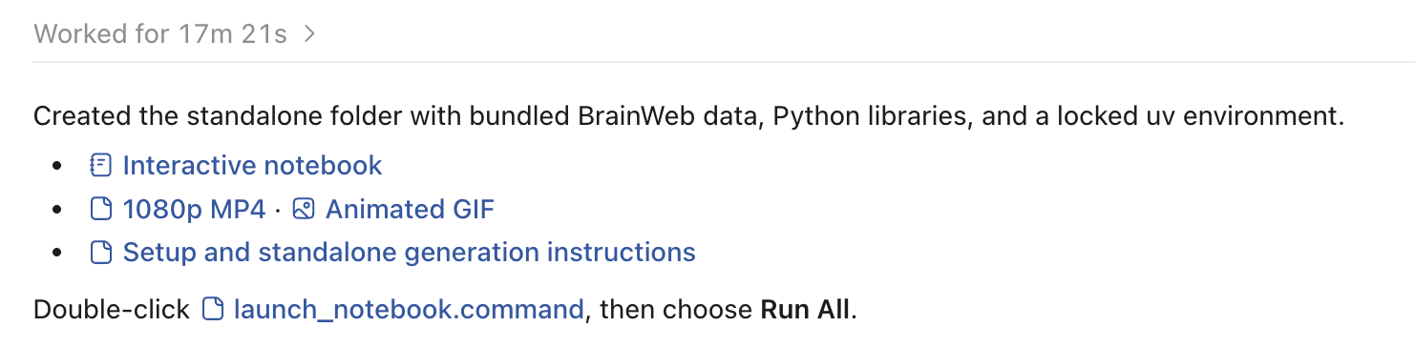
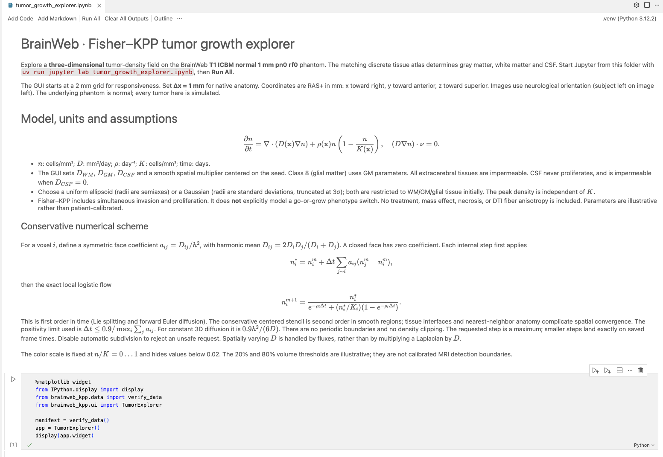
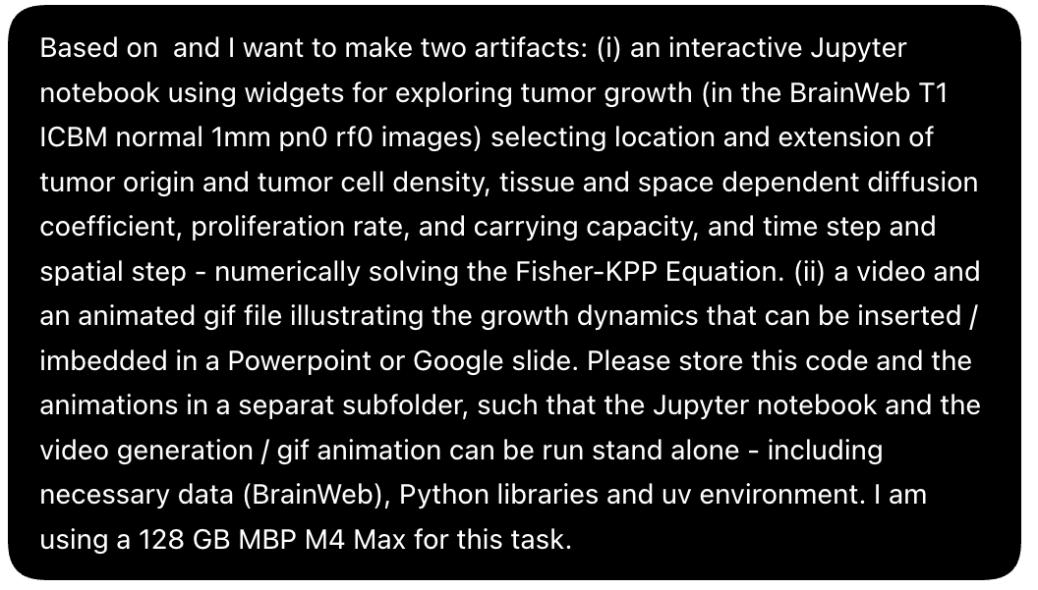
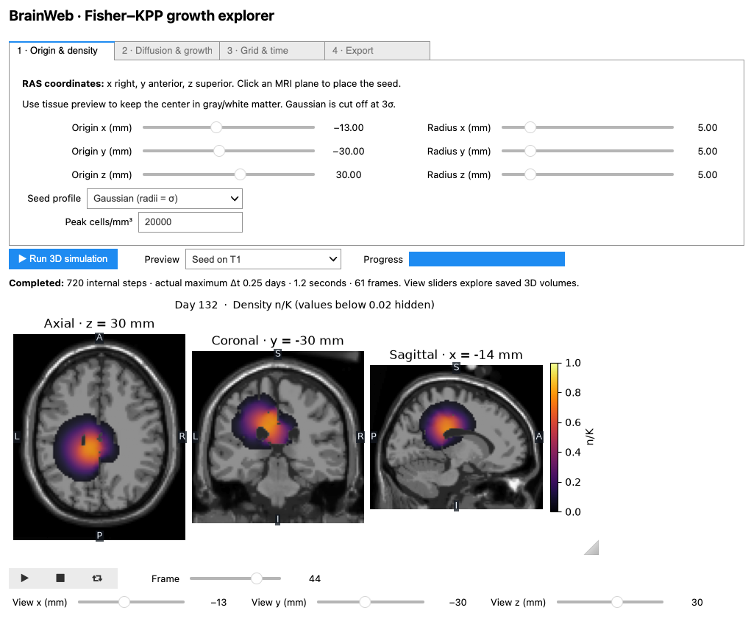
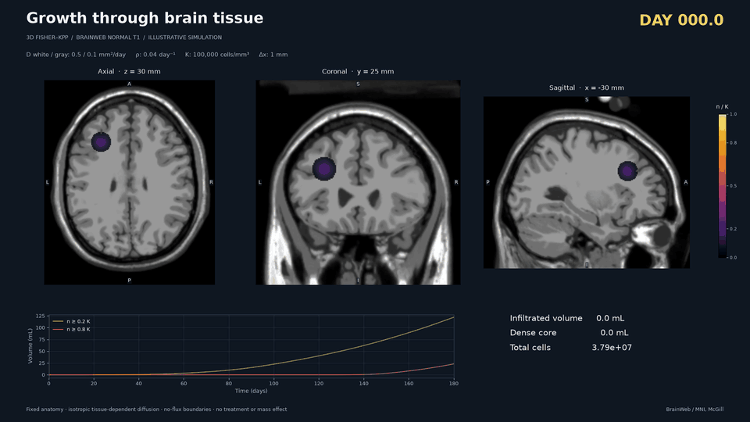

AI-assisted tumor growth modelling
Prompt:
https://github.com/arvidl/brainweb_fisher_kpp

Slide 19
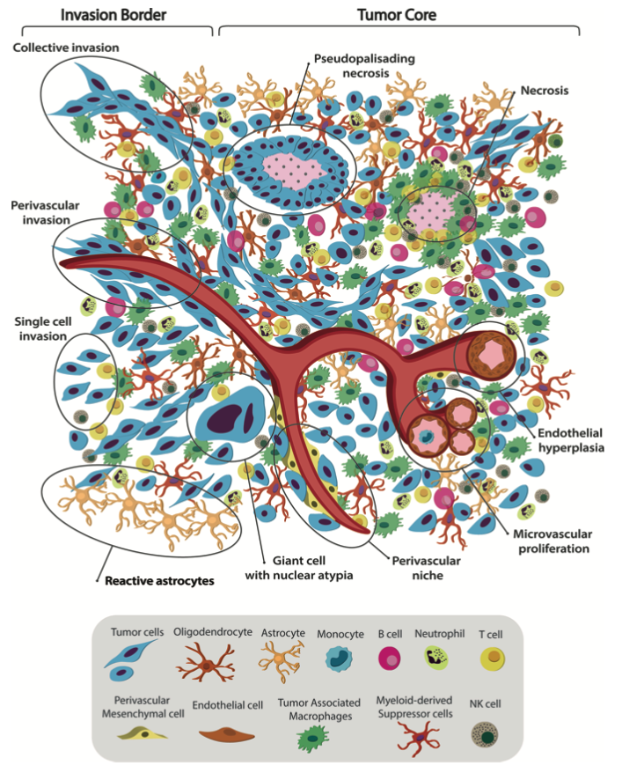
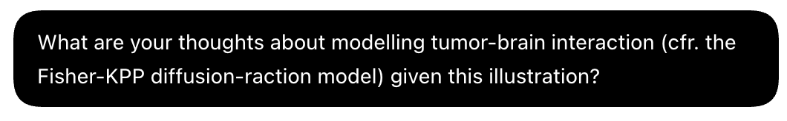
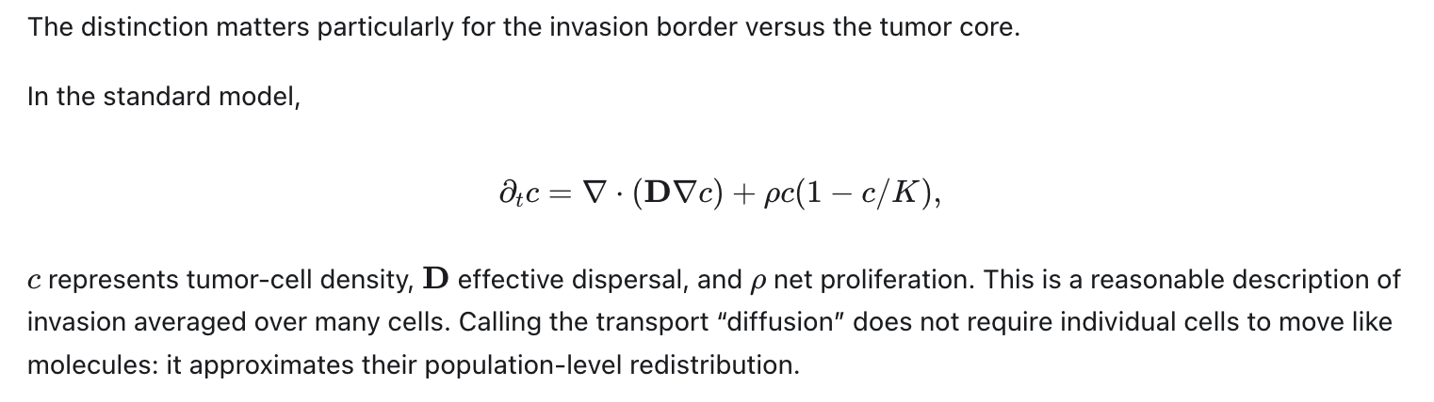
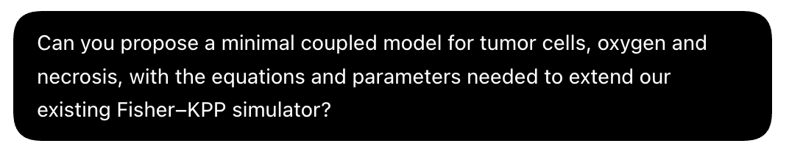
Follow-up
prompt:
A. Comba et al. Uncovering Spatiotemporal Heterogeneity of High-Grade Gliomas. Front Oncol 2021;11;703764

Slide 20
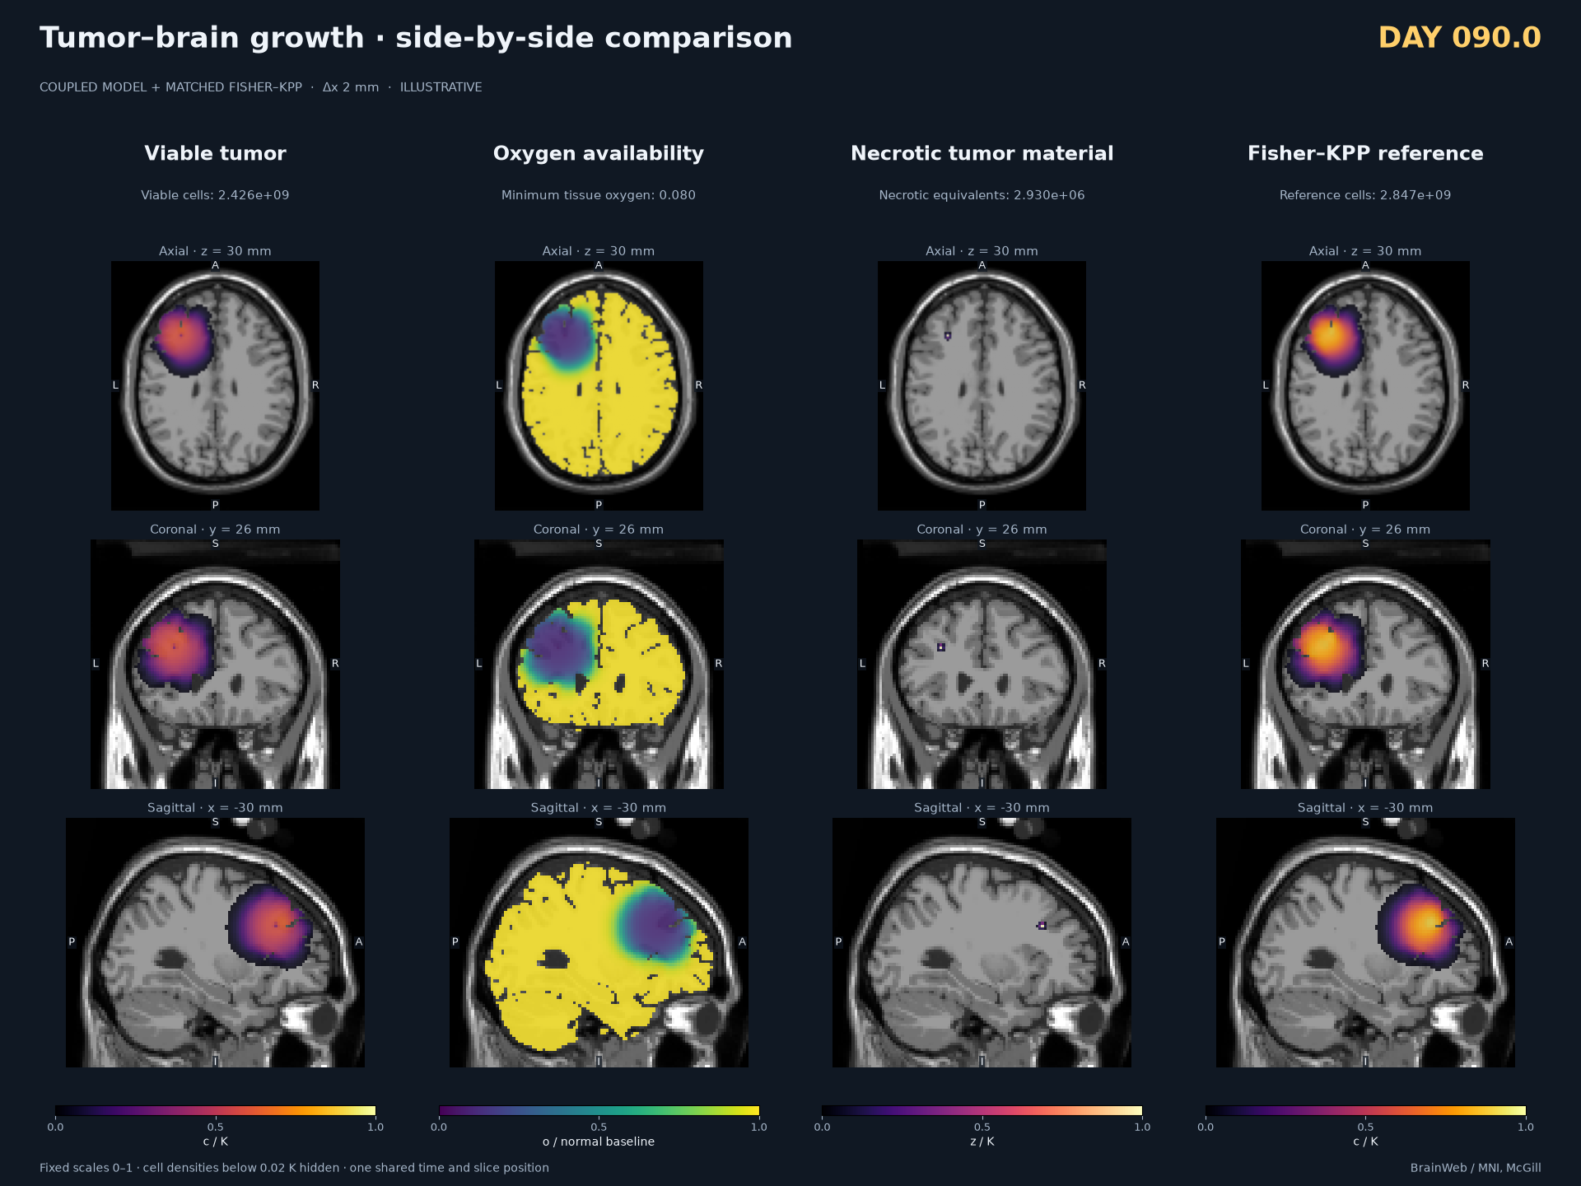
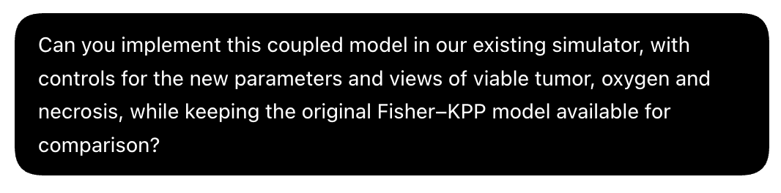





3D implementation
visualisation
https://github.com/arvidl/brainweb_fisher_kpp

Slide 21



22 October 2026
Nature Reviews Methods Primers 2026;6:82
Agentic AI aims to structure scientific decision-making into traceable workflows, coordinating reasoning and actions through natural language (incl. “voice mode”)
Output from agentic systems can be classed into four groups:
extracted knowledge
ranked hypotheses
iterative refinement of candidates
empirically validated scientific knowledge
Agentic systems can generate different outputs even when the same prompt is used.
Reproducibility reporting must distinguish between technical and independent replicates to reveal any divergence in output.

Slide 22

The Research Workflow
(from idea to reporting)
Idea
  Initial concept or question
Literature Review
  Existing research, knowledge gaps
Research Questions
  Precisely testable hypothesis or question
Study Design
  Methodology, participants, variables
Applications
  Ethics approval
  Financing
Implementa-
tion
  Execution, collection of data
Data Analysis
  Processing, analysis, statistics, interpretation
Reporting
  Publishing, peer reviews
  Dissemination
Further Studies
  New studies and collaboration
  Research-
based teaching
KI-akselerert forskning
AI support / AI collaborator / AI agents
https://github.com/arvidl/AI-assisted-glioma-research

Slide 23


Words: Eirik Sjåholm Knudsen (Molekyl M.020)
Music: made with Suno v5.5, lyrics from the post
Film: made in code with Claude Opus 5.5, by Eirik Sjåholm Knudsen
https://www.molekyl.io/p/m030-something-has-changed
▶ Watch the video
MP4

Slide 24

Prof. Eirik S. Knudsen
https://www.molekyl.io

Slide 25


Thank you !
CODE
https://atomurl.net/qrcode

